Slide 1



The Value of
Occupational Health
© All Health Matters Ltd Registered in England & Wales No: 7148874 ARTOHI0521

Slide 2

“Occupational health specialists enhance employee health, workforce productivity, business performance and the economy”
Occupational health: the value proposition – A report from the Society of Occupational Medicine

Slide 3
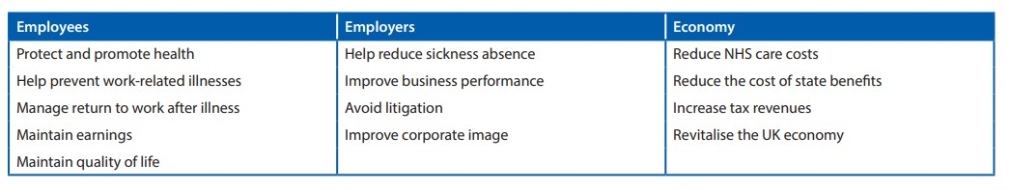
Research shows that companies who invest in occupational health (OH) benefit from added value through reduced sickness absence and improved productivity. OH also contributes towards improved corporate image, better quality of life for employees, and avoidance of litigation.
The benefits provided by occupational health services:
Table from: Occupational health: the value proposition – A report from the Society of Occupational Medicine pg6

Slide 4
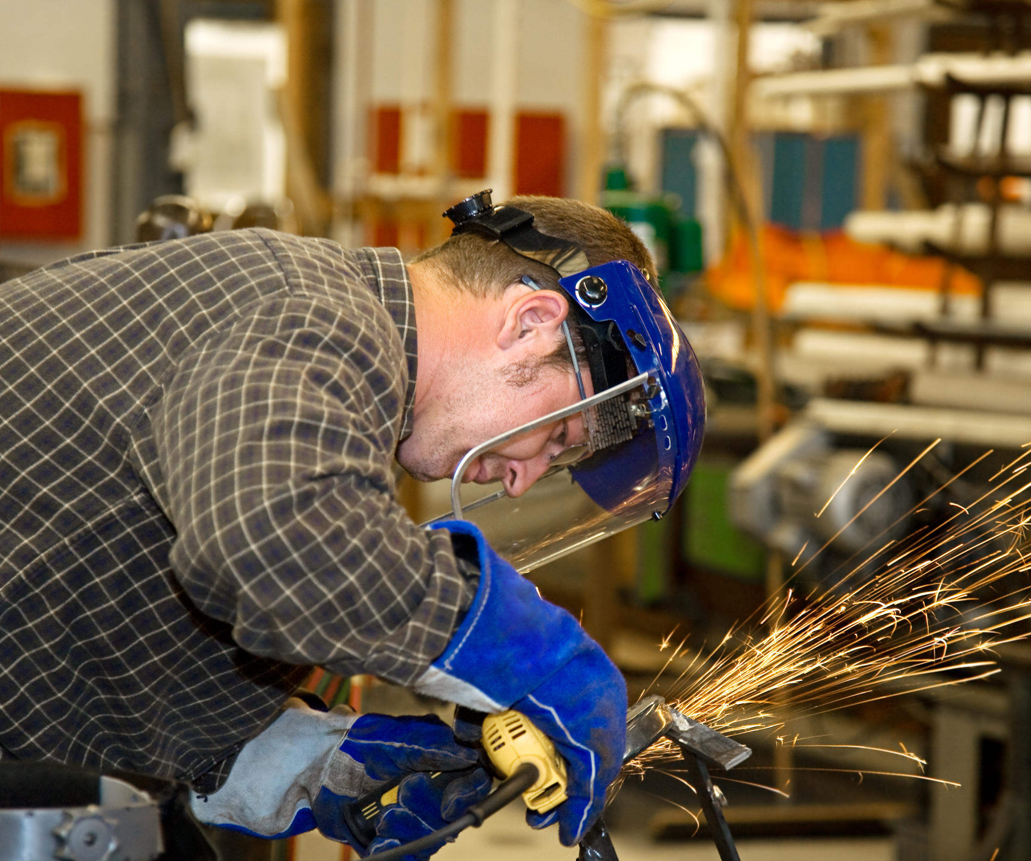
What is OH?
Occupational Health is all about people at work, and making sure they are fit enough to do the job and healthy enough to enjoy the benefits of doing it.
OH is relevant in any industry, but the specific OH needs of businesses vary depending on the nature of the work.

Slide 5

OH services may include (but are not limited to)…
Pre-placement health screening (questionnaires/ medicals)
Health surveillance – for workers exposed to health hazards at work (noise, vibration, dust etc)
Fit to work medicals – when a minimum level of fitness is required for the role
Management referrals – to help employers manage an employee with health issue (sickness absence management / return to work advice / reasonable adjustments etc)
Drug & alcohol testing – at pre-placement, ‘for cause’, or routinely as part of drug & alcohol policy
DSE / Workstation assessments – ergonomic assessments for VDU users
Wellbeing campaigns – educating & empowering employees to lead healthy lifestyles
Occupational & travel vaccines – for those at risk or travelling for business

Slide 6
Where OH fits
All Health Matters believe that the ‘dream-team’ of any OH strategy should comprise close collaboration between HR managers, H&S managers and OH

Slide 7

Why businesses invest in OH
Legal obligations:
DSE Assessments for VDU users
Health surveillance where work falls under:
  Control of Noise at Work Regulations 2005
  Control of Substances Hazardous to Health (COSHH) Regulations 2002
  Control of Asbestos Regulations 2012
  Control of Vibration at Work Regulations 2005
  Manual Handling Operations Regulations 1992
  Control of Lead at Work Regulations 2002
  Ionising Radiations Regulations 2017 (list not exhaustive)
Duty of care – Employers have a duty of care under the Health & Safety at Work Act to protect the health of their employees. Occupational health can help fulfil this duty.

Slide 8

Why businesses invest in OH
Financial benefits & loss mitigation:
Avoid litigation – Fines from the HSE and/or work-related ill health cases brought by employees can be prevented with help from OH
Reduce sickness absence costs – Early intervention can help prevent sickness absence & OH can often help people return to work sooner if they do go off sick, or provide recommendations on medical capability
Maintain reputation - Business could be lost if reputation damaged. Having effective OH strategy improves reputation and avoids risk of damage.
Boosts productivity - 43% of employees would feel they have a duty to work harder for an employer who took health and wellbeing seriously. Aviva. The Sixth Health of the Workplace Report. Aviva. Norwich. 2012

Slide 9

Why businesses invest in OH
Moral reasons:
Corporate social responsibility – Employees spend approximately 30% of their lives at work & employers are well placed to provide health education and support, contributing to CSR
Provide safe & healthy work environment – Employees who feel safe and cared for at work will benefit from improved physical and mental health, contributing to the success of the business
Support for valued employees – Employee morale, loyalty, and retention can all be improved by providing access to relevant OH services

Slide 10
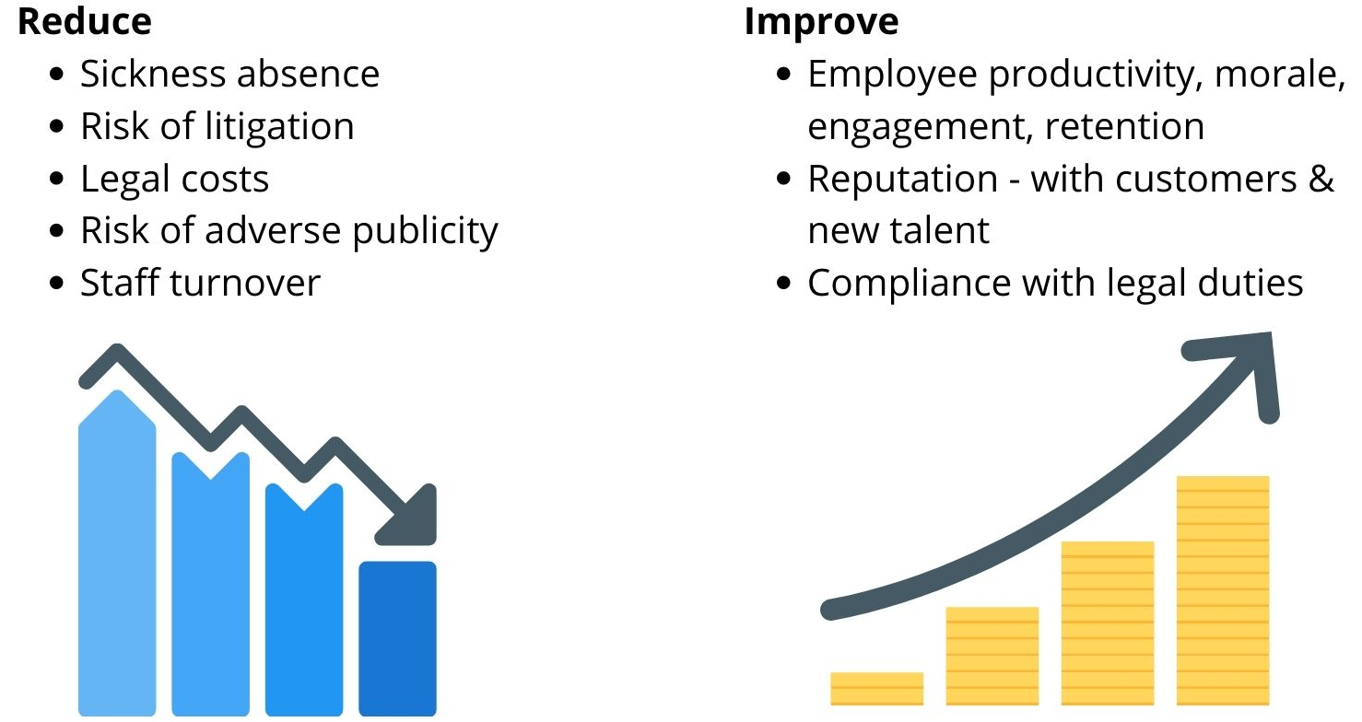
Why businesses invest in OH

Slide 11
Getting started with OH
Assess your needs – Each business has unique OH needs depending on the number of employees, the nature of work, geographic location etc. Health & Safety and HR teams can usually identify which OH services would be beneficial, but things like CSR policy may also be a driver. Do you just want the essentials, or do you also want the ‘nice-to-haves’?
Choose a provider – Providers should be able and qualified to meet your needs. There are different levels of OH specialists from doctors to nurses, to HSE appointed specialists – who you need depends on your needs assessment. The HSE has advice about choosing a provider here.
Communicate with employees – If OH is new, it can be daunting to existing employees. Be clear about what the OH service is and isn’t, and how it will affect them. Your provider may be able to help with resources.
Review regularly - Check the service still meets your needs – a good provider will flex with your business.

Slide 12



More information about the value of OH
This has been a very brief introduction to OH and the benefits it can bring to any business.
For more information, we recommend the following resources & websites:
Occupational health: The value proposition (Society of Occupational Medicine report 2017)
HSE – Occupational health overview
Acas – Using occupational health at work
CIPD – Occupational health
  If you’d like to have a chat about your needs, you can contact All Health Matters with no obligation. We’ll never sell you services you don’t need:
  03300 948 900 admin@allhealthmatters.co.uk

Slide 13
Healthy business needs healthy people
www.allhealthmatters.co.uk

